Slide 1
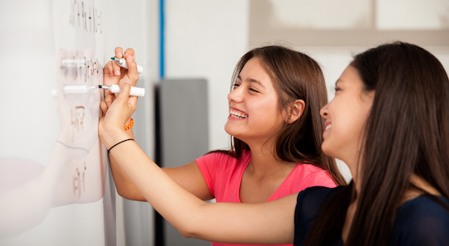
Problem Solving Session
The remainder of today’s class will comprise the problem solving session (PSS).
Your instructor will divide you into teams of 3 or 4 students.
Each team will work together to solve the following problems over the course of 20-30 minutes.
You may work on paper, a white board, or digitally as determined by your instructor.
You will submit your solution by pushing it to GitHub before the end of class.
Your instructor will go over the solution before the end of class.
Class participation is a significant part of your grade (20%). This includes in class activities and the problem solving session.
Your Course Assistants will grade your participation by verifying that you pushed your solutions before the end of the class period each day.

Slide 2

Problem Solving Team Members
Record the name of each of your problem solving team members here.
Do not forget to add every team member’s name! Your instructor (or course assistant) may or may not use this to determine whether or not you participated in the problem solving session.

Slide 3
Problem Solving 1
Write a function that uses a while loop to draw sequence of red pixels. The number of pixels should be provided as an argument.
pixart.red_pixels(8)

Slide 4
Problem Solving 2
Write a function that returns True if a string is a palindrome, and False otherwise. Consider at least the cases in the table below.
Input | Result
"" (empty string) | True
"a" | True
"aa" | True
"ab" | False
"abcba" | True
"abcab" | False

Slide 5
Problem Solving 3
Write a function that uses a for loop to print each word in a string on a separate line without using the split() function.
Hint: Iterate over the characters in the string and check for spaces.
>>> word_by_word("this is a test")
this
is
a
test
>>>

